Slide 1

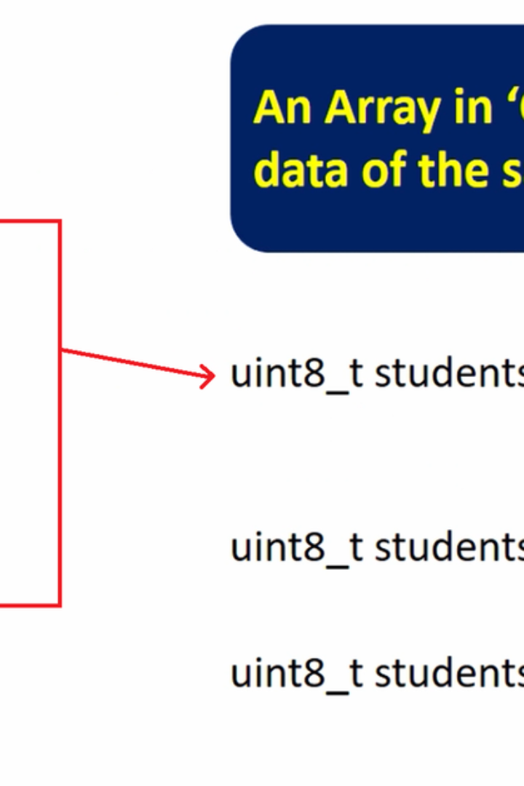
Introduction to Arrays in C Language
An array is a data structure that stores a fixed-size sequence of similar elements. Learn the basics of arrays in C and how they are used in programming.

Slide 2
Array Syntax in C
Declaration
Initialization
int numbers[5];
int numbers[] = {1, 2, 3, 4, 5};
Accessing Elements
Modifying Elements
int x = numbers[2];
numbers[3] = 10;

Slide 3
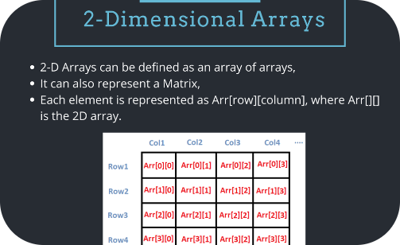
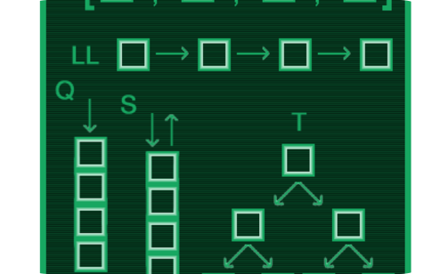
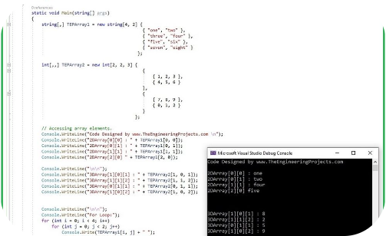
Multi-dimensional Arrays in C
Declaration
Initialization
Accessing Elements
int matrix[3][3];
int matrix[][] = {{1, 2, 3}, {4, 5, 6}, {7, 8, 9}};
int x = matrix[1][2];

Slide 4
Manipulating Arrays in C
1
Array Indexing
2
Sorting
Access individual array elements using their index.
Arrange array elements in a specific order (e.g., ascending or descending).
3
Searching
4
Insertion/Deletion
Find the position or value of a specific element in the array.
Add or remove elements from the array.

Slide 5
Common Array Operations in C
Operation
Example
Sum of Array Elements
int sum = 0; for (int i = 0; i < size; i++) sum += array[i]; return sum;
Finding Maximum Element
int max = array[0]; for (int i = 1; i < size; i++) if (array[i] > max) max = array[i]; return max;
Linear Search
int search(int array[], int key) { for (int i = 0; i < size; i++) if (array[i] == key) return i; return -1; }

Slide 6

Conclusion
1
Arrays Recap
Arrays are essential in C and other programming languages for storing and manipulating data efficiently.
2
Applications
Arrays are used in a variety of applications, including sorting, searching, and data manipulation.
3
Further Learning
Continue exploring arrays to become a skilled programmer and problem solver.

